Slide 1


Ala-Too International University
Pong Game
Baktybekova Bermet
Can Sueda

Slide 2
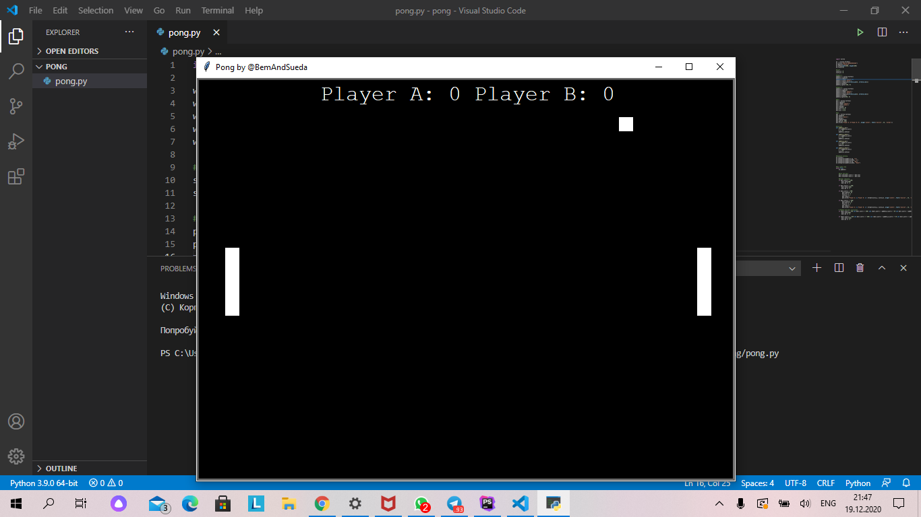
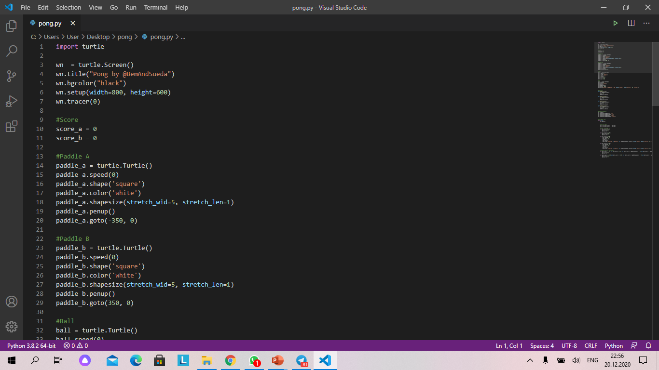
What is the project about?
Pong is a simple sports table tennis simulator. A small square that replaces a ping-pong ball moves across the screen. If it hits the perimeter of the playing field, then its trajectory changes. If the ball is hit by the player's racket, then its movement additionally depends on the speed and direction of the racket.

Slide 3
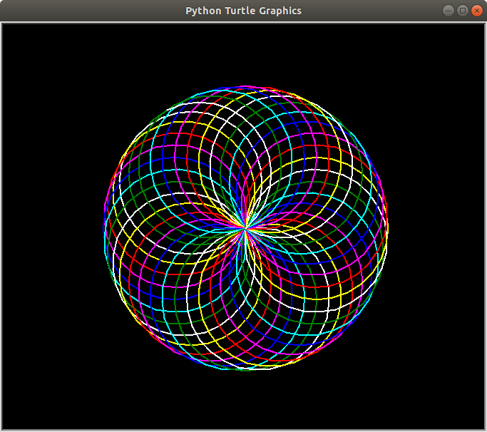
The libraries we used
The turtle module is an extended reimplementation of the same-named module from the Python standard distribution up to version Python 2.5. It tries to keep the merits of the old turtle module and to be (nearly) 100% compatible with it.

Slide 4
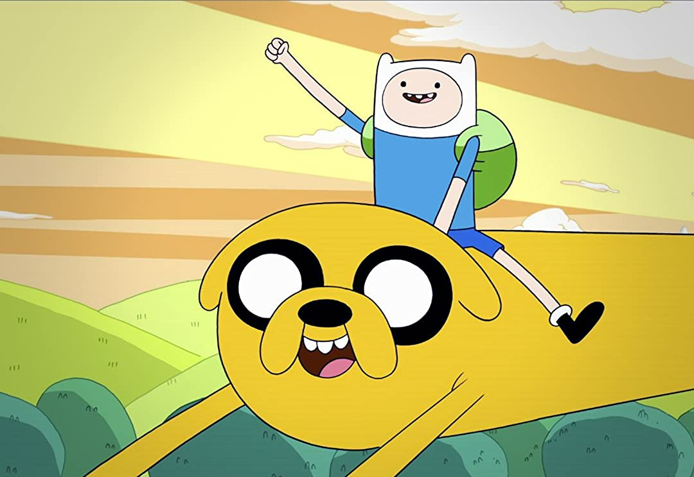
Thanks for attention!

